Slide 1

UNIVERSITY INSTITUTE OF ENGINEERING
COMPUTER SCIENCE ENGINEERING
Bachelor of Engineering (Computer Science & Engineering)
Subject Name: Internet of Things
Subject Code: 20CST-357
Proliferation and IoT Devices
DISCOVER . LEARN . EMPOWER

Slide 2
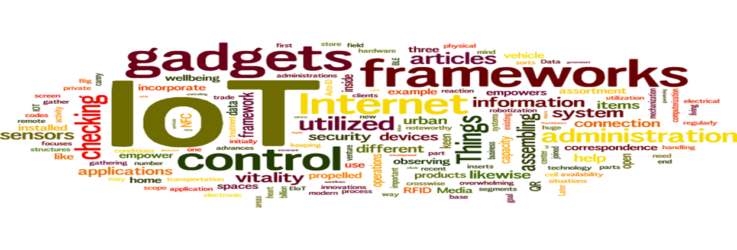
Internet of Things
Course Outcomes:
1. Analyze the basic terminologies associated with IoT and use it.
2. Justify the applications of internet of things and correlate them.
3. Compare different objects and communication strategies and also able to see the issues raised by communication strategies in IoT.
4. Examine the protocols required for communication and packet size required for each application.
5. Illustrate security issues with IoT like security, privacy, communication standard and some other legal issues.

Slide 3
UNIT 3 CHAPTER 6 Proliferation and IoT Devices

Slide 4
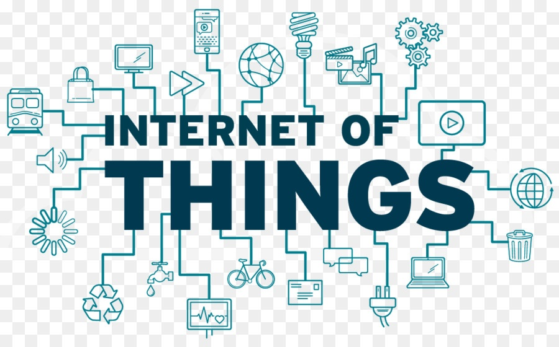
Internet of Things
IoT used in Legal Actions, Regulatory, Legal, and Rights Issues Summary
Emerging Economy and Development Issues: Ensuring IoT Opportunities are Global
Economic and Development Opportunities.

Slide 5
IoT used in Legal Actions, Regulatory, Legal, and Rights Issues Summary (CO-5)
Legal Issues
After having defined the challenges and ethical issues, a new legal question about the ability of the existence of laws ready to protect users in such an environment arises.. This is a major concern because the border between physical and virtual is almost transparent in IoT.
The following questions are examples for issues needed to be discussed.
1-What will happen when internet goes down in medical applications, who is responsible, who will be sanctioned? Is it the medical service provider or the local or global internet service provider?
2-Who is responsible for patching new IoT devices to be sure its fully secured?
3-Are the standards and laws ready to deal with these situations?
4-What happens if a medical service provider is out of business? What is the fate of the patients, how the data will be used?
5-When these devices should take a break from collecting data?

Slide 6
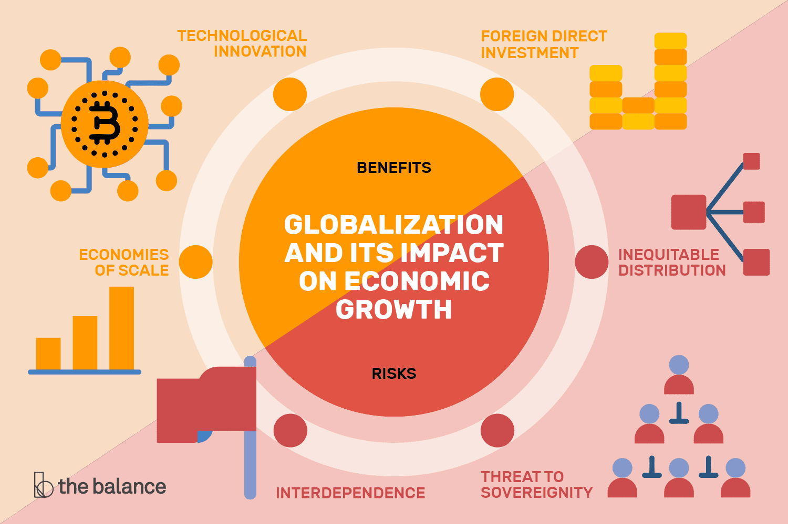

Slide 7
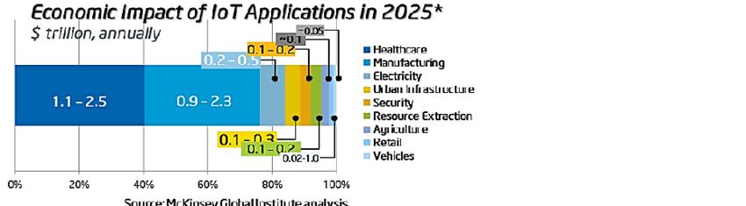

Slide 8
Legal and regulatory aspects in the Industrial IoT
1. Fair access to connectivity bandwidth
2. Responsibility, Accountability and Liability Issues
3. IoT Law about Data Handling
4. Unlawful profiling
5. Privacy and Security
6. Ownership of data
7. Automated contracts

Slide 9
Emerging Economy and Development Issues: Ensuring IoT Opportunities are Global (CO-2)
The Internet of Things holds significant promise for delivering social and economic benefits to emerging and developing economies. This includes areas such as sustainable agriculture, water quality and use, healthcare, industrialization, and environmental management, among others. As such, IoT holds promise as a tool in achieving the United Nations Sustainable Development Goals. The broad scope of IoT challenges will not be unique to industrialized countries. Developing regions also will need to respond to realize the potential benefits of IoT.

Slide 10
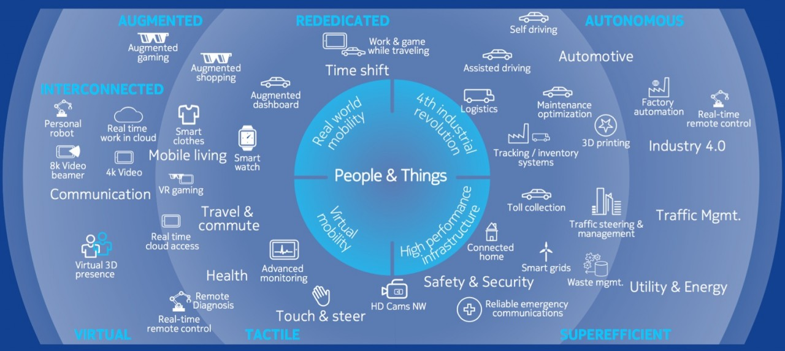

Slide 11
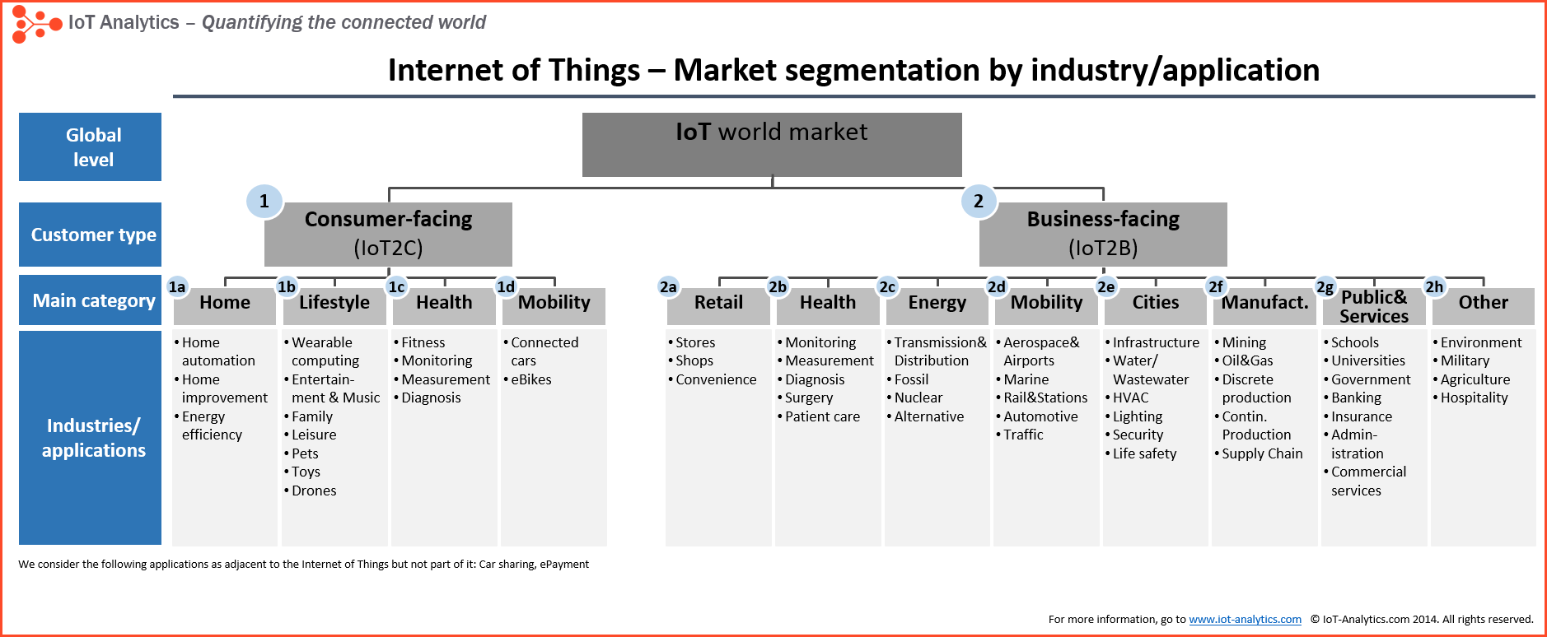

Slide 12
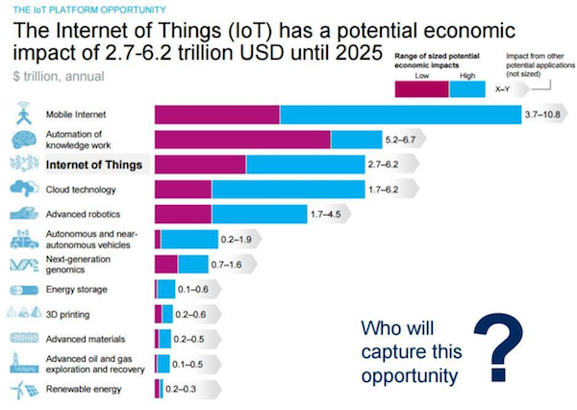

Slide 13
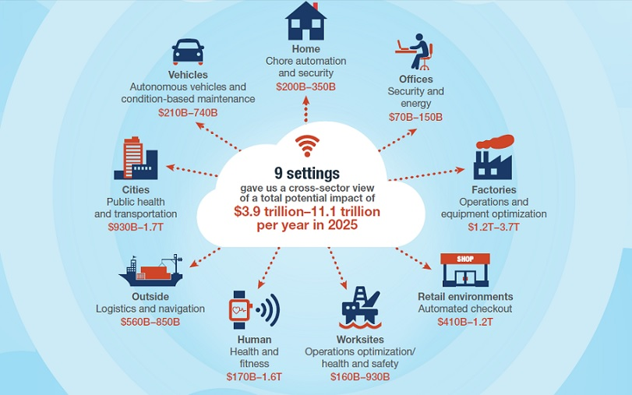
Economic and Development Opportunities (CO-2)

Slide 14
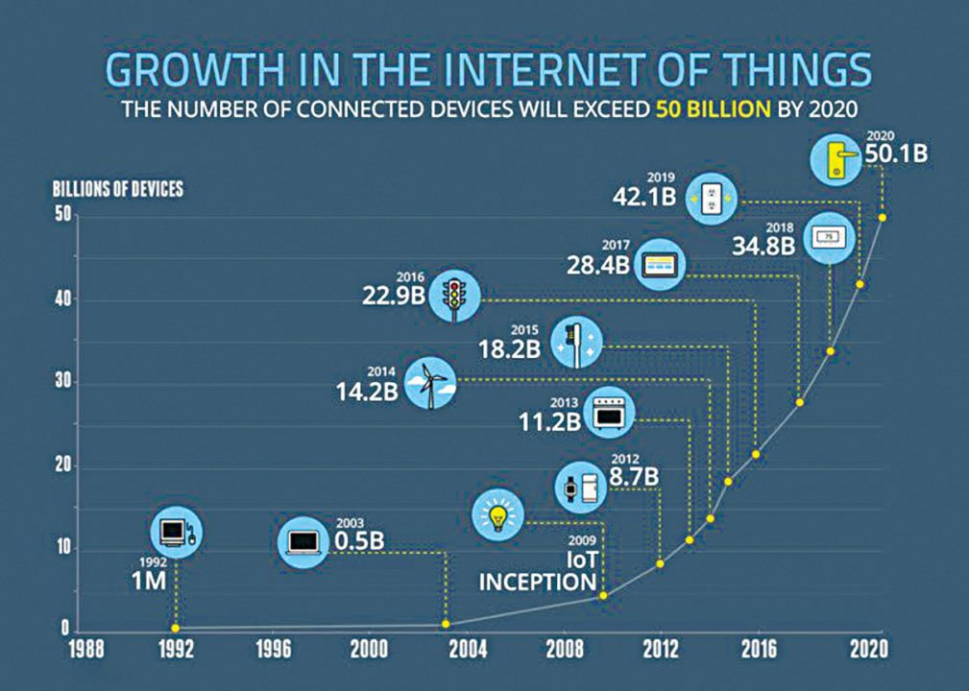

Slide 15
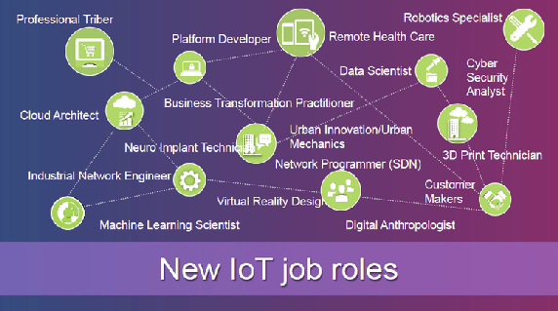

Slide 16
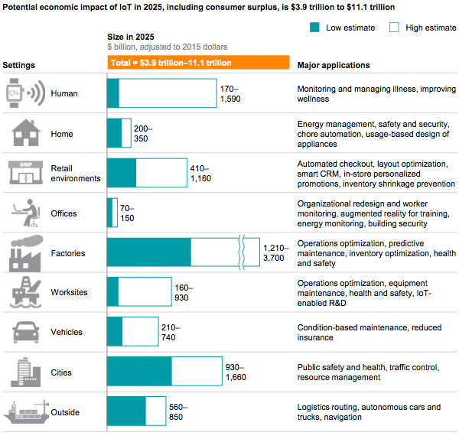

Slide 17
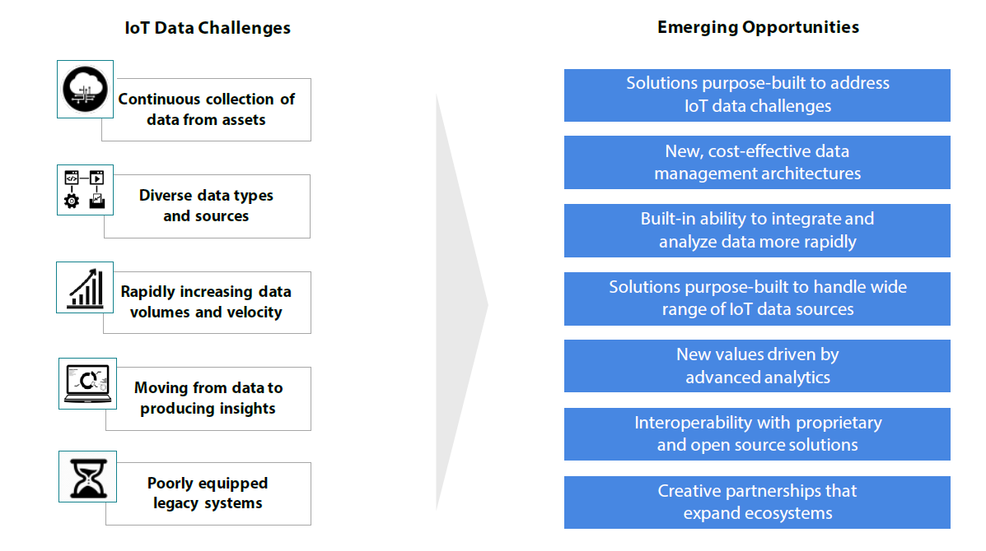

Slide 18
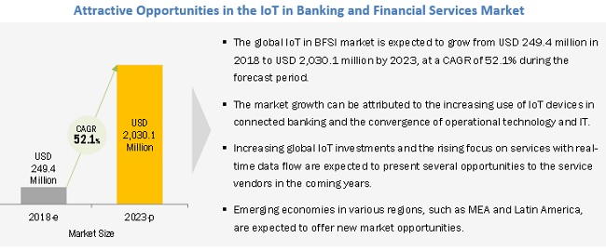

Slide 19
Summary
The majority of the device-enablement value pool is based in the Americas, where it was worth €5.5 billion in 2018. Device enablement’s importance to the IoT and its global revenue growth also means that both technological and business opportunities will be almost geography-agnostic and grow at similar rates. And although enterprise customers will remain the largest customer segment, device-enablement platforms will see fast uptake among small and mid-sized customers.
The growing market for IoT technology reflects some of the ways in which maturing technologies have begun to fulfill the promises of the IoT. PE funds should evaluate opportunities to leverage IoT in their portfolio companies and look for emerging investment opportunities in both the IoT market and in sectors that can reap outsized benefits from these technologies.

